Slide 1
MEMORANDUM OF SETTLEMENT between Canadian Union of Public Employees Local 1975 (CUPE 1975) and University of Saskatchewan Collective Bargaining Agreed To Language
Signed February 10, 2026

Slide 2
Presentation to
CUPE Local 1975 General Membership Meeting
Please note the presentation includes only the language where amendments have been agreed to.
If language is being removed, it is struck out (i.e.)
If language is being added, it appears in black and bold. The remainder of the collective agreement remains unchanged.

Slide 3
ARTICLE 1 – SCOPE
1.3 Plural Terms and Gender
Whenever the singular masculine or feminine is used in this Collective Agreement, it shall be considered as if the plural, feminine or masculine has been used where the context so requires. Wherever possible, gender-neutral language will be used.

Slide 4
1.4.2 Non-Permanent Employees:
A term employee is an employee who works on a full-time or part-time basis for a specific period of time or replaces a permanent employee who is absent for an extended but limited period such as a leave of absence or disability.
When an employee (except excluding an apprentices under Article 15.4.5) has been in held the same term position continuously for more than thirty (30) months, their status will be changed to permanent. This period extends to (forty (40) months in the case of if an employee is replacing an absent. employee due to disability, or subsequent employees due to backfilling), that employee's status will be changed to permanent.

Slide 5
1.4.2 Non-Permanent Employees:
A casual employee is an employee who is appointed to work that, due to its nature, cannot be scheduled, anticipated or projected, or is work of a limited duration. Payment of casual employees will be on an hourly basis.
Casual employees shall not work more than five (5) consecutive work days (full or partial) and cannot work more than thirty (30) work days (full or partial) per calendar year from the date of commencement in the casual appointment.

Slide 6
ARTICLE 4 – UNION SECURITY
4.1 Union Membership
All employees who are now, or hereafter become, members of the Union shall maintain their membership in the Union as a condition of their employment, and all new employees whose employment commences hereafter shall, within twenty (20) thirty (30) calendar days after the commencement of their employment, apply for and maintain membership in the Union as a condition of their employment.
The Employer will provide contact information for the CUPE office and direct all new employees to the Union Office as part of the normal enrollment procedure.

Slide 7
ARTICLE 6 – USE OF EMPLOYER'S PREMISES
6.3 Bulletin Boards
The Employer shall provide Union bulletin boards as follows:
Administration Building Marquis Hall Arts Building University Services Building Physical Activity Complex (PAC) Williams Building Health Sciences Building (2) Science Complex Veterinary Medicine Engineering Building Education Building Central Heating and Cooling Plant

Slide 8
6.3 Bulletin Boards (Continued)
The Union shall have the right to post notices of meetings and such other notices as may be of interest to its members. The Union will not otherwise post any notices on the Employer's premises without prior written permission from the Dean, Administrative Head or designate.

Slide 9
ARTICLE 8 – VACANCIES AND PROMOTION
8.1 Posting
All vacant positions, excluding positions defined under Articles 1.4.2(b), 1.4.2(c), 1.4.3 or terms of four (4) months or less, will be posted weekly on the University job posting website. Unposted terms shall not be extended beyond four (4) months without posting the position, unless otherwise agreed to by the parties. The Union will be provided access to unposted term reports.
Such posting shall contain the following information: nature of position summary, qualifications, shift, department/unit and wage or salary rate or range. Such qualifications shall not be established or amended in an unreasonable manner.
Vacancies in Phase 1 of all Job Families, apprenticeship positions and vacancies in the entry level Phase 2 positions identified in Article 8.4 will be posted as open positions available for public competition.

Slide 10
8.4 Basis for Selection
Vacancies in Phase 1 of all Job Families and apprenticeship positions and vacancies in the following entry level Phase 2 positions will be filled on the basis of the skill, ability and qualifications of the applicants: Technician, Labourer, Facilities Attendant, Library Assistant, Storekeeper, and Culinary Lead. Where these factors are relatively equal, the Employer will select the most senior applicant.
All other vacancies shall be filled through appointment on the basis of greatest seniority, required qualifications, and satisfactory performance and efficiency demonstrated in the applicant's current or previous position(s) with the Employer. Efficiency demonstrated shall be as documented in the employee's file. An employee shall be deemed as demonstrating satisfactory performance if there is no documentation on the employee’s personnel file to indicate otherwise.
Selection decisions will be in compliance with the Federal immigration legislation and in accordance with Article 25 of this Agreement.

Slide 11
If there is not a qualified internal applicant, the Employer will consider on the same basis as outlined in Article 8.4 above, the applications of employees who are close to possessing the required qualifications before considering any external candidate. If an appointment is made of an applicant who does not possess the required qualification(s) of the position, the Employer may, as a condition of appointment, require that the applicant obtain the qualification(s) within a specific time limit. If the employee fails to meet the required qualifications within such time limit (outside of their assessment period), the employee will be provided with termination and severance under Article 12.1.4.
Selection decisions will be in compliance with the Federal immigration legislation and in accordance with Article 25 of this Agreement.

Slide 12
8.5 Reversion Rights in a Term Position
An employee, except casual or student employees, may bid on a posted term position and will be given preference in accordance with Article 8.4. A permanent employee filling a posted term position will continue to be a permanent employee and will be entitled to all contract rights and benefits, including benefit plans. A permanent employee shall maintain reversion rights to their prior permanent position for up to six (6) months in the term position. Reversion rights may be extended by mutual agreement. Beyond that period, when the posted term position ends either automatically or prior to its stated expiration date, a permanent employee holding the position will have the protection of Article 12.1.6.
Reversion rights for employees under a formal Secondment temporary transfer arrangements are as per Article 8.9.

Slide 13
8.9 Secondment Temporary Transfer Arrangement
In an effort to support career development and advancement as well as the promotion of employment stability and minimizing disruption to the workplace, whenever possible, Temporary Transfer Arrangements should be utilized to fill term positions.
Definition: A temporary transfer of a permanent employee or assignment to another area of the Institution with a guarantee of return to the employee’s former position upon completion of the Secondment temporary transfer arrangement. Secondments Temporary transfer arrangements may be lateral or promotional in nature and may be within CUPE 1975 or another bargaining unit or to a role that is exempt from a bargaining unit.
In an effort to support career development and advancement as well as the promotion of employment stability and minimizing disruption to the workplace, whenever possible, secondment agreements should be utilized to fill term positions.

Slide 14
These arrangements are established through posted job competition, in accordance with Article 8.1.
A secondment agreement temporary transfer arrangement must be in writing, requires an agreement in writing, signed off by both unit leaders, and the employee, and Human Resources. The agreement will be for a specified period of time and the employee's permanent position will be protected for the duration of the assignment. A copy of the secondment agreement shall be provided to the Union. Secondment Agreements may be for a period of three (3) up to twenty- four (24) months.
Should any party wish to extend or terminate the agreement prior to its original end date, discussions shall occur between all parties. Subsequent agreement to extend or terminate must be mutually agreed upon by all parties. Early termination of the secondment agreements will include no less than fourteen (14) calendar days and no more than thirty (30) calendar days' notice to allow for the parties to prepare for any workplace implications.
The provisions of Article 9.3 Assessment Period shall also apply.

Slide 15
Should the seconded employee be successful in acquiring an alternate permanent position during the life of the secondment agreement, the employee will notify their home department, as well as the department in which they are serving the secondment of their acceptance of a new position.
Should the seconded employee's home position become redundant during the life of the secondment agreement, the provisions of Article 12.1 shall apply.

Slide 16
ARTICLE 9 – PROBATIONARY AND ASSESSMENT PERIOD
9.3 Assessment Period
9.3.1 Appraisals During Assessment Period
Throughout the Assessment Period, management will provide timely and constructive feedback that is relevant to meeting the requirements of the position. At a minimum, this will occur at the mid-point (1.5 months) of the Assessment Period and necessary improvements will be provided, in writing, to the employee.
NEW
9.3.2 Where the assessment period has passed without a final meeting with the employee, the employee will be deemed to have successfully completed and passed their assessment period.

Slide 17
ARTICLE 10 – SENIORITY
10.2 Loss of Seniority
10.2.6 Seasonal Layoff for a period exceeding twelve (12) months;

Slide 18
ARTICLE 11 – COMPENSATION
11.1 Wage Ranges Schedules
All positions within the Union are compensated within the wage ranges schedule attached in Appendix 1. The establishment of wage ranges schedules shall be the subject of negotiation and agreement between the Employer and the Union.
11.2 Placement and Review of Positions
Placement and review of positions will be determined according to the following procedure:
11.2.1 New Positions
New positions within the scope of CUPE 1975 will be placed in a Family and Phase by Human Resources based on the criteria set out in the job placement manual. Any employee who believes the position has been inappropriately placed may request a review in accordance with Article 11.2.2.

Slide 19
11.2.2 Review of Position Job Family and/or Phase
Any employee and/or supervisor/manager, Dean, Administrative Head or designate, who believes a position has significantly changed and the current placement no longer accurately reflects the position, may request a review, in writing. The review can occur only once per twelve (12) month period and will be conducted by Human Resources.
Human Resources will conduct its review and provide a written decision and reasons within sixty (60) days of receipt of the application in Human Resources. Where circumstances warrant, the parties may mutually agree to extend the sixty (60) day timeline.

Slide 20
11.2.3 Salary Adjustments through Transfer, Promotion, or Review
If an employee transfers into a different position, their wage will be placed within the salary range phase and step for the new position.
If an employee is promoted or an employee's position is promoted or reclassified into a different family and/or to a higher phase, their wage will be placed within the salary phase and step range for the new position. If an employee is promoted into a higher phase or a position is placed in a higher phase, the employee will move to the appropriate step in the determined phase, with a minimum increase of four percent (4%), rounded up to the nearest step will be realized.
If an employee's current wage is above the wage range, the wage will remain red-circled.
Employees will be informed of any change by Human Resources.
The effective date for any wage adjustments shall be the pay period following the date the application was submitted by the applicant to their reporting manager. Wage adjustments will be processed after the thirty (30) day appeal period, under Article 11.2.4, has lapsed.

Slide 21
11.2.4 Appeal of Position Review Decisions
Either party may request an appeal within thirty (30) calendar days of receipt of the written decision by Human Resources. The Joint Appeal Committee (consisting of two (2) CUPE and two (2) management representatives appointed by the parties) will review these requests and render a decision. All appeal decisions are final and not subject to the grievance procedure. In the event the Joint Appeal Committee does not reach consensus, the parties will seek the assistance of a mutually agreed-to and paid for third party expert whose decision shall be final and binding. A position which has been the subject of an appeal may not be the subject of another review (and appeal) until twelve (12) months have elapsed since the appeal decision was rendered.
The effective date for any wage adjustments shall be the pay period following the date the application was submitted by the applicant to their reporting manager. Wage adjustments will be at the appropriate step in the determined phase, with a minimum increase of four percent (4%), rounded up to the nearest step.
Notwithstanding the above, no employee will have a reduction in base wage as a result of this process. Wage adjustments will be processed after the appeal decision is rendered.

Slide 22
11.3 Regular Increment Step Advancement
11.3.1 After each completed year of service, employees will increase by one (1) step within the wage schedule up to the maximum step of their positions’ phase.
As per the definition of service, the employee’s service date will be adjusted for leaves of absence without pay in excess of thirty-one (31) calendar days. When an employee’s service date is adjusted, the annual date to increase by one (1) step will be adjusted accordingly.
Two percent (2%) increments up to the maximum of the wage range are provided annually (commencing January 1, 2007 and each January 1 thereafter) to recognize growth in proficiency from experience and a satisfactory level of performance to employees with greater than one (1) year of continuous service. Employees with less than one (1) year of continuous service will be eligible for a pro-rated increment on the basis of the number of days by which their employment precedes January 1.

Slide 23
11.3.2 If an employee's performance is rated unsatisfactory the two percent (2%) increment may be withheld. An employee's performance may only be rated as unsatisfactory if the employee fails to meet communicated performance expectations. A disciplinary record, where a penalty has already been imposed, will not itself be a basis for an unsatisfactory performance rating.
11.3.3 Where an employee has had an increment withheld in the preceding year for unsatisfactory performance and where the employee is eligible for and receives an increment in the following year, then the withheld two percent (2%) increment will be added to the following year's increment and paid from the date of that following year's increment forward, but not paid retroactively for the year it was withheld, subject to the range maximums.

Slide 24
11.3.4 An employee, within thirty (30) days of being notified by Human Resources that their increment is being withheld, may appeal the withholding of their increment on the basis of unsatisfactory performance. The Joint Appeal Committee (consisting of two (2) CUPE and two (2) management representatives appointed by the parties) will review these appeals and render a decision within sixty (60) days or such longer time as the committee may agree. All appeal decisions are final and not subject to the grievance procedure. In the event the Joint Appeal Committee does not reach consensus, the parties will seek the assistance of a mutually agreed to and paid for third party expert who, if unable to bring about a consensus, may render a final and binding decisions.
11.6.2 Notwithstanding Article 11.6.1, the Employer may establish new student positions within the Scope of CUPE 1975. Accordingly, new positions will be placed within the current range of established FAPA rates by mutual agreement between Human Resources and CUPE 1975 based on a review of the position profile description developed by the Employer.

Slide 25
ARTICLE 12 – LAYOFF
12.1 Layoff Due to Change in or Reduction of Programs or Services
Housekeeping changes:
12.1.2 change Secondment to Temporary Transfer Arrangement
12.1.6 change job description/profile to position description
12.1.7 c. i. The employee is offered a position under bumping (Article 12.1.6) and declines or fails to respond within seven (7) calendar days indicating intention to accept or not to accept the position offered; or
12.3 Technological Change
The parties recognize that the University and its employees are affected by the rapid expansion of knowledge and the constant modification of technology. This may require employees to modify their job knowledge and skills from time to time.

Slide 26
12.3.21 Consultation
In an attempt to keep employees apprised informed of current and anticipated modifications to the day-to-day work techniques of various occupations of employees, the Employer and the Union agree to meet from time to time as necessary. In addition, when Human becomes aware of impending significant technological change at the Employer, it will undertake to call such a meeting.
In cases of technological change which directly affects conditions of employment, the Employer and the Union agree to enter into consultation, at the request of either party, prior to implementation.

Slide 27
Consultation may include such things as:
the nature of the technological change to be introduced, including detailed description of the change and the rationale for the change
timing of such changes The timing or date on which the Employer proposes to effect the technological change
The effect(s) that the technological change may have on the terms and conditions or security of employment of employees.
reassignment of duties
effects on terms and conditions of employment
plans for retraining relative to existing employees adapting to new equipment or work methods
establishment of a rate of pay to be provided during training and arrangements for the costs of materials and/or tuition
arrangements for assessment of an employee’s suitability for training and arrangements for periodic assessment of an employee’s progress while in training.

Slide 28
Where permanent positions are being abolished eliminated, such consultation may include be to consideration for training and/or redeployment.
Such training may be for an existing position on campus or may only be intended to supplement an employee’s skills. Where retraining and/or redeployment does not take place, then the provisions of Article 12.1 will apply.

Slide 29
12.3.12 Reduction in Work Force
If the work force is reduced due to technological change, and employees whose jobs positions are being eliminated are not entitled to the rights and benefits conferred by Saskatchewan legislation, they will be entitled to the benefits outlined in Article 12.1 and Article 12.3.3.
12.3.2 a) Notice
If any permanent employee’s job is eliminated because of technological change, the affected employee will be given three (3) months’ notice in writing.
In addition, Human Resources, when it becomes aware that any employee’s position will be eliminated
because of technological change, Prior to providing notice to any employee, Human Resources will notify the Union and consultation will be initiated under Article 12.3.1. (See Article 12.3.2).

Slide 30
12.3.3 12.3.2 b) Severance Pay
An employee who loses seniority rights (Article 10.3.6) or who terminates employment will receive pay on the basis of two (2) weeks’ pay at the employee’s current salary for every year or portion of a year’s service.
12.3.4 Other Applicable Clauses
In the event that a permanent employee’s position is eliminated due to technological change all the provisions of the clauses in Article 12.1 apply.
12.4 Grievances Concerning this Article
Grievances concerning technological change this Article shall be initiated in accordance with Article 14 – Grievance Procedure. Within thirty (30) days of the commencement of a layoff or the notice of recall, at the first stage of the grievance procedure, and directed to Human Resources.

Slide 31
ARTICLE 15 – LEAVES OF ABSENCE
15.2 Compassionate Care and Special Leave of Absence
15.2.2 Special Leave of Absence
Notwithstanding Article 15.2.1, special leave of absence without pay shall be granted to an employee for good and sufficient reason and shall not be unreasonably denied. Application must be made to their Dean, Administrative Head or designate, indicating the reason for such leave.

Slide 32
15.4 Education Leave
15.4.2 Employee Development
15.4.2.1 Tuition Waiver for University of Saskatchewan Credit Courses
Employees will have the opportunity to have tuition fees waived for a maximum of six (6) credit units per fiscal year (May 1 to April 30) for courses taken at the University of Saskatchewan, up to a maximum of two thousand dollars ($2,000) per employee. The funds available for tuition waiver will be capped at twenty thirty thousand dollars ($20,000) ($30,000) per fiscal year (May 1 to April 30). Registration should be completed through the normal class registration procedure and will be accessed through Staff and Students Accounts, Financial Services Division.
Registration should be completed through the normal class registration procedure and will be accessed through Staff and Students Accounts, Financial Services Division. Student Finance and Awards.
The Employer reserves the right to suspend tuition waivers once the fund available is fully subscribed.

Slide 33
15.5 Compassionate and/or Bereavement Leave
If required by the circumstances from one-half (1/2) to three (3) days of regularly scheduled work days leave shall be granted by the Dean, Administrative Head or designate because of the death or life-threatening illness of a spouse, parent, child, brother, sister, mother-in-law, father-in-law, grandparent, grandchild, brother-in-law, sister-in-law, or other person who would ordinarily be considered a member of the employee's immediate family. The meaning of spouse in this paragraph shall be defined as Section 2-1 of The Saskatchewan Employment Act.
An Employee may request and shall be granted bereavement leave for up to five (5) days in the event of the death of the Employee's spouse, common-law spouse, parent (including step-parent or foster parent), child (including step-child, foster child, loss of pregnancy); sibling (including step-sibling or foster sibling), grandparent, grandchild, mother-in-law, father-in-law, aunt, uncle, cousin, niece, nephew, brother-in-law or sister- in-law, or any person over whom the employee has legal responsibility, any other person who would ordinarily be considered like a member of the employee’s family.

Slide 34
The request is made to the Dean, Administrative Head or designate as soon as possible and confirmed in writing. The time off will be granted as requested. However, the question of whether any of the time granted or how much of the time granted is with loss of pay or benefits may have to await determination until the request in writing has been reviewed and will depend upon the circumstances of the request.
The Dean, Administrative Head or designate may, at its discretion, under certain circumstances and after the receipt of an application in writing:
grant additional time off with or without pay;
give consideration for leave to attend the funeral for individuals other than those provided above; of other close relations.
consider granting reasonable travel time in addition to the leave granted under this Article.

Slide 35
15.8 Maternity/Adoption/Parental Leave
15.8.1 Service Requirements for Maternity/Adoption/Parental Leave
An employee shall qualify for maternity/adoption/parental leave (leave of absence without pay) after thirteen (13) consecutive weeks with the Employer. The Employer shall not deny a pregnant employee the right to continue employment during her their pregnancy provided she they can supply a medical certificate as to her their fitness to do so, if so requested.
15.8.2 Length of Maternity/Adoption/Parental Leave
Maternity/adoption/parental leave shall be taken at the employee’s discretion before and/or after the birth or adoption of a child. Length and timing of the leave shall be consistent with the provisions in The Saskatchewan Employment Act.

Slide 36
New
15.8.3 Maternity Leave, Special Circumstances
If you are a pregnant employee and a loss of pregnancy occurs in week twenty (20) or later, you may be eligible to receive maternity benefits consistent with the provisions in The Saskatchewan Employment Act.
If you are a pregnant employee and a loss of pregnancy occurs before week twenty (20), you may eligible for sick leave benefits under Articles 18 and/or 19.3.

Slide 37
15.8.34 Supplementary Employment Benefits (SEB)
After successful completion of the probationary period and provided they are in receipt of federal Employment Insurance (EI) benefits, women employees on maternity leave, or an employee who has declared to Human Resources that the employee is the primary caregiver of the child, will receive the difference between EI benefits received from Human Resources Development Canada and ninety-five percent (95%) of the employee's salary while on leave for a maximum of fifteen (15) weeks, or the equivalent amount prorated to accommodate an extended leave as per the provisions in The Saskatchewan Employment Act, subject to the condition that the employee's earnings (from EI, earnings, and any other source) cannot exceed one-hundred percent (100%) of pre-leave earnings.
The employee's accumulated sick leave and vacation leave at the time the leave commences shall be retained to the employee's credit. Benefits will be in accordance with Article 19.

Slide 38
ARTICLE 16 – HOLIDAYS
16.2 Holidays Falling on Saturday or Sunday
When any of the above-noted holidays falls on a Saturday or Sunday and is not proclaimed as being observed on some other day, the Associate Vice-President, People and Human Resources, shall notify the Union, in advance of the applicable calendar year of what day will be deemed the holiday for the purposes of this Collective Agreement.

Slide 39
ARTICLE 17 – VACATION
17.4 Time of Vacation
Employees, insofar as the regular operation of their departments permit, will be allowed to take their vacations at the time they request. Employees must request vacation and receive approval in advance of its intended use.

Slide 40
ARTICLE 18 – SICK LEAVE
18.1.1 Two-Week Waiting Period
Subject to the availability of sick leave credits, sick leave may be used to offset the two (2) week waiting period for eligibility of receipt of Federal Employment Insurance (EI) maternity leave benefits for the birth mother or primary caregiver (see Article 15.8.3).
18.4.2 Where no one other than the employee can provide for the needs of a member of the employee's immediate family during a serious illness, the employee may apply (by email or telephone, confirmed later in writing) to their Dean, Administrative Head or designate for permission to have up to five (5) days of accumulated sick leave per illness for this purpose. Serious illness need not mean life threatening and it is understood the seriousness of the illness may be related to the age of the family member. The employee may be required to provide medical evidence of the serious illness.

Slide 41
18.6 Proof of Illness
In accordance with The Saskatchewan Employment Act, if the employee has been absent for more than five (5) consecutive working days or has had non-consecutive absences of two (2) or more working days in the preceding twelve (12) months, the Employer, and/or third party designate, reserves the right at any time during to request the employee to submit a medical certificate documentation signed by a medical doctor certifying that the employee was unable to carry out duties due to illness. , or that the employee undergo at the earliest opportunity a medical examination conducted by a doctor specified by the Employer and at the Employer's expense. The Employer will not unreasonably request a proof of illness from the employee.
In addition, and in accordance with The Saskatchewan Employment Act, the Employer is not precluded from requesting proof of illness where it can be demonstrated that the employee has a record of absenteeism and there is no reasonable expectation of improved attendance.

Slide 42
The costs associated with submitting medical notes or forms required from a medical professional for paid sick leave, Short-Term Disability and/or Long-Term Disability is the responsibility of the employee. Eligible expenses may be submitted to the employee’s Health Spending Account (HSA) for reimbursement.
In certain circumstances, the University may require the employee to provide satisfactory medical evidence through an independent medical examination (IME), and such examination shall be at the University’s expense.
18.9 Compensation from a Third Party
When an employee is involved in an accident away from work or any other action that involves the possibility of reimbursement for lost wages or damages from a third party (including no fault, package policy, tort, etc.) the employee shall, as soon as possible, notify the Health and Wellness Resource Centre Wellness Resources to advise of the injury.

Slide 43
Article 19 – Employee Well-being and Benefit Plans
19.3.2 Pension Plan (closed to new entrants as of August 31, 2019)
a) Non-Academic Pension Plan (closed to new entrants as of August 31, 2019)
The plan is administered in accordance with the terms of the plan and the Memorandum of Agreement dated June 28, 2019 and benefits are in accordance with the terms of the plan and the Memorandum of Agreement dated June 28, 2019.
The Employer shall make contributions to the plan in accordance with the terms of the plan.
The parties agree that the pension plan defines a form of deferred compensation which exists for the sole benefit of the members of the pension plan and their beneficiaries. On the advice of the actuary, after having established adequate reserves, any remaining surplus will be used for the benefit of members and beneficiaries.

Slide 44
b) Colleges of Applied Arts & Technology (CAAT) DBplus Pension Plan
Each full-time or part-time permanent employee shall enroll in the Colleges of Applied Arts & Technology "CAAT" DBplus Plan in accordance with the Memorandum of Agreement dated June 28, 2019.
The Employer and employees shall each make contributions to the plan in accordance with the terms of the plan and the Memorandum of Agreement dated June 28, 2019.
19.4 Employee Status While on Disability Plan
An employee drawing benefits from either the Short-Term Disability Plan or the Long-Term Disability Plan will retain seniority rights in the same manner as if at work. The employee will retain coverage in the benefit plans, for which he/she was they were enrolled in prior to going on disability. Pension contributions are per Article 19.6.3.

Slide 45
19.67 Benefits During Leave of Absence
19.6.2 Sick Leave, Vacation Leave and Increment Date
If leave of absence (except as provided in Articles 15.1 and 15.3) exceeds thirty-one (31) calendar days, credits for sick leave and vacation leave will not be accumulated during the period of absence. If the leave of absence is for thirty-one (31) days or less than thirty one (31) calendar days, the employee will continue to accumulate sick leave credits and vacation credits in the normal fashion.
An employee will continue to accumulate sick leave credits and vacation credits in the normal fashion during the fifteen (15) weeks of Supplementary Employment Benefits (Article 15.8.3) or during the twelve (12) weeks of Supplementary Employment Benefits (Article 15.4.5.6). Sick leave credits and vacation credits will not accumulate during any other period of maternity/adoption/parental leave.

Slide 46
19.6.3 Pension Plan
If the leave of absence (except as provided in Article 15.1 and 15.3) is fifteen (15) days or less than fifteen (15) calendar days, contributions to the pension plan will not be affected.
If the leave is for greater than fifteen (15) days in any one (1) month, contributions to the pension plan will be discontinued unless prior arrangements are made with the Employer.
When an employee is on Short-Term Disability or Long-Term Disability, the employer agrees to maintain both employee and employer contributions.

Slide 47
When an employee is receiving fifteen (15) weeks of Supplementary Employment Benefits (Article 15.8.3) or during the twelve (12) weeks of Supplementary Employment Benefits (Article 15.4.5.6), regular contributions will be made to the pension plan and matched by the employer. At the completion of the fifteen (15) weeks of Supplementary Employment Benefits (Article 15.8.3) contributions to the pension plan will be discontinued unless prior arrangements are made with the Employer. After the twelve (12) weeks of Supplementary Employment Benefits (Article 15.4.5.6) contributions to the pension plan will be discontinued unless prior arrangements are made with the pension plan.

Slide 48
NEW
19.67 Duty to Accommodate
In keeping with the requirements of The Saskatchewan Employment Act and The Saskatchewan Human Rights Code and Regulations, the University and the Union acknowledge that employers and unions have a duty to accommodate.
Where an employee has identified a need for an accommodation, they may submit a written request to the University. The request for accommodation must be supported by appropriate formal documentation.

Slide 49
ARTICLE 20 – OCCUPATIONAL HEALTH AND SAFETY
20.6 No Disciplinary Action
No employee shall be disciplined for refusal to work on a job or operate any equipment which, in the opinion of the employee(s) or any member of the Safety Committee, is unsafe, until an Occupational Health Officer or an Occupational Health Committee established under Part III – Occupational Health and Safety, of The Saskatchewan Employment Act, has investigated the matter or situation, or until sufficient steps have been taken so that the employee has reasonable grounds for believing that the duty or duties are not no longer unusually dangerous.

Slide 50
ARTICLE 22 – MISCELLANEOUS
22.5 Rules and Regulations
When the Employer introduces new rules or regulations concerning employees’ conduct on Employer premises or during working hours, copies will be reviewed with all applicable staff, posted and also forwarded to the Union office. Such rules and regulations will be reasonable and will not be inconsistent with any article in the Collective Agreement.
22.8 Access to Personnel File
Each employee member, will, after having made an appointment with Human Resources, have reasonable access to the contents of their file. The review will be conducted in the presence of a Human Resources representative. The employee member may assign in writing the right to review their file to their Union representative. Upon request the employee shall be provided with copies of documents in the file at the employee's expense. The employee may add a signed and dated response to any material in the file. Material not present in the file may not be used in any decision under Articles 8, 9, 12, or 13 without that information being made available to the employee.

Slide 51
ARTICLE 23 – HOURS OF WORK
23.1 The following regular hours of work are in effect:
Group A | Clerical, Retail Services and Library Group: | thirty-five (35) hours paid per week, seven (7) hours paid per day.
Group B | Animal and Poultry Science (Farm): | thirty-eight (38) hours paid per week which may be balanced over a two (2) week period with a maximum of forty-five (45) hours paid in any one week.
 | Horticulture: | thirty-eight (38) hours paid per week, 7.6 hours paid per day.
 | Culinary Services, Maintenance and Trades, Caretakers, Technical: | thirty-eight (38) hours paid per week, 7.6 hours paid per day, five (5) consecutive days unless otherwise mutually agreed. Technician IV working hours by mutual agreement with Dean, Administrative Head or designate.
Group C | Steam Central Heating and Cooling Plant, and Security Protective Services: | thirty-eight (38) hours paid per week, 7.6 hours paid per day. Alternatively, employees in Group C may be required to work modified schedules (10 or 12 hours).

Slide 52
23.2 Earned Days Off
c) General Provisions Regarding Earned Days Off
1. Schedules under this alternative may vary, but as general principles:
(i) Hours of work will be altered in a way which will permit those participating to take full days off.
(ii) Wherever possible, time off will be given in conjunction with normal days of rest, vacation, or in blocks of time.
(iii) Schedules may be modified from time to time to meet special needs of work units, but schedules will not be altered unreasonably.
(iv) Accumulated time will be taken within a year of being earned.

Slide 53
2. Unless otherwise indicated, days off are treated as normal days of rest.
3. Sick leave and vacation utilization is recorded consistent with Article 17 and Article 18 and is based on actual hours absent to the maximum hours of work for the position.
4. Additional time worked in order to accumulate time off shall not constitute overtime, nor shall it result in any additional premium pay.
5. For the purpose of accumulating the earned day off, sick, vacation and banked time will be counted based on the appropriate longer working day.
6. Notwithstanding the above, an employee or group of employees may request to opt out of an Earned Days Off (EDO) schedule and continue to work and be paid for the appropriate longer working day. All requests are subject to approval of the Employer.

Slide 54
Article 24 – Overtime and Special Pay
24.3 Shift Premium
24.3.1 For time actually worked, a permanent, term, recurring relief or casual employee will receive an additional one dollar and twenty five fifty cents ($1.25) ($1.50) per hour for each hour or part of an hour of regularly scheduled work outside the hours of 8:00 am to 6:00 pm Monday through Friday. If the majority of an employee's hours of work on a shift fall outside the hours specified above, the premium will be paid for the entire shift.

Slide 55
ARTICLE 25 – THE AGREEMENT
25.1 Duration
This Collective Agreement shall be effective from January 1, 2025, and shall remain in force and effect up to December 31, 2028, and from year to year thereafter, but either party may, not less than thirty (30) sixty (60) days nor more than sixty (60) one hundred and twenty (120) days prior to the expiry date hereof, give notice in writing to the other party to negotiate a revision thereof.
Notwithstanding the above, with consent of the parties, negotiations for a new Collective Agreement may commence six (6) months prior to the expiration of the current contract.

Slide 56
MEMORANDUM OF AGREEMENT No. 2 May 7, 2014 January 21, 2026 (Revised) Hours of Work
Whereas Where the University indicates that the altered hours of work schedule is compromising operational efficiency, productivity or and customer service in certain areas in the organization;
And whereas, the "Utilization of Earned Days Off" MOU in the collective agreement provides that the parties will, on a case by case basis, determine methods by which EDOs can be provided in work units while not compromising operational efficiency or increasing loss of productivity or service to the public;
And whereas, the Union expressed a willingness to discuss hours of work and recognizes that a different practice may be necessary to meet the operational needs of certain units;
Now therefore, in consideration of these facts, the parties agree to following process:
Where a unit identifies a concern that is compromising the operational efficiency, productivity or service, the parties agree to discuss alternatives to an EDO schedule on a case by case basis.
If the parties are unable to agree on alternate arrangement, the parties shall submit the matter to a third party mediator mediation in accordance with the Memorandum of Understanding No. 1 "Utilization of Earned Days Off".
Should no agreement be reached through mediation, the matter will be referred to arbitration.

Slide 57
Memorandum of Agreement No. 5 April 11, 2018 January 21, 2026 (Revised) CUPE Local 1975 President Compensation
The University agrees to facilitate the full payment of salary and benefits to the President of CUPE Local 1975 via the regular payment service process. This will include any top-up of salary covered by CUPE Local 1975. Effective April 15, 2018, the pay rate for the CUPE Local 1975 President will be the equivalent of the top of the current Phase VI salary band under the Collective Agreement between the University of Saskatchewan and CUPE Local 1975. Should the compensation structure change as a result of collective bargaining, the compensation rate will remain consistent with the top of the new compensation grid (consistent with trades supervisory staff).
Temporary Performance of CUPE 1975 Presidential Duties
Where a member of CUPE 1975 executive is assigned to perform duties of the CUPE 1975 President, for a period of five (5) consecutive days or more, compensation will be provided at ten percent (10%) of the employee’s current salary for the assigned period up to the maximum of Phase VI salary band.

Slide 58
MEMORANDUM OF AGREEMENT No. 7 Pandemics January 21, 2026 (Revised)
The Employer and Union agree that the COVID-19 Pandemic caused significant disruption to the Employer’s operations and its workforce and to the community they serve. Through the appropriate joint forums, the parties will commit to discussing impacts to the workforce and strategies that encourage all employees to adhere to public health orders and guidance and that minimize the impact of this and any future pandemic in the workplace and in the greater community.

Slide 59
APPENDIX 3 MEMORANDUM OF AGREEMENT Between The University of Saskatchewan And CUPE Local 1975
Re: Casual Facilities & Program Assistants (FAPA), College of Kinesiology
6. When Aquatics Instructors have completed three (3) terms, in which they work at least thirty-five (35) hours per term, they will be eligible to receive a swimsuit allowance.
The allowance will be paid once per eligible employee per calendar year provided that the requirement for minimum hours worked per term is met. The three (3) qualifying terms need not be consecutive.
Swimsuits must meet [reasonable] criteria established by the College. Aquatics employees that meet the criteria above will be reimbursed to a maximum of $80 one hundred dollars ($100.00) per calendar year. Proof of purchase, including the original detailed receipt, must accompany all requests for payment of the allowance.

Slide 60
7. Hours of work for FAPA aquatic staff in the job titles of Leadership Class Instructor and Instructor will be scheduled such that one hundred and sixty (160) hours will be averaged over four (4) weeks. Overtime will not apply until such time as the hours worked exceed this amount over the four (4) week period. This provision applies only to those persons noted above and only in the delivery of the following Royal Lifesaving Society or Red Cross programs:
Water Safety Instruction
Red Cross Water Safety Instruction
National Lifeguard Service
CPR/First Aid Instruction
Red Cross Assistant Lifeguard and Lifeguard
Red Cross Lifeguard Transfer
Life Saving Instructor
Bronze Medallion
Bronze Cross
Other programs as mutually agreed
Although time off is provided for breaks, lunch and dinner, staff will continue to receive regular pay through any break time as well. Paragraph 7 will be considered to comply with The Saskatchewan Employment Act.

Slide 61
Schedule B – FAPA Rates of Pay (effective January 1, 2026)
USASK REC PROGRAMMING AND SERVICES CLASSIFICATIONS | Hourly Rate
USask Rec Student Assistant | $13.00 $15.35
USask Rec Fit Centre Assistant USask Rec Climbing Wall Assistant | $13.75 $15.75
USask Rec Student Administrative Assistant | $16.25
USask Rec Student Coordinator | $15.25 $17.25
USask Rec Student Team Lead | $18.75
USask Rec Student Specialist | $21.00
Aquatics Guard | $15.50 $17.50
Aquatics/PAAL Instructor | $16.75 $18.75

Slide 62
Schedule B – APA Rates of Pay (effective January 1, 2026) (Continued)
Aquatics Leadership Instructor | $18.75 $20.75
Personal Trainer | $23.65
HUSKIE ATHLETICS PROGRAMMING AND SERVICES CLASSIFICATIONS | Hourly Rate
Huskie Athletics Student Assistant | $13.00 $15.75
Huskie Athletics Student Coordinator | $15.25 $17.25
Huskie Athletics Student Team Lead | $19.75
Huskie Athletics Student Specialist | $22.00

Slide 63
Wage increases shall be subject to negotiation between the parties.
* Notwithstanding the minimum hourly rates above, the Employer may pay FAPA student employees above the minimum where qualifications, market, or other business reasons warrant a higher hourly rate of pay. Once per academic term, the Employer will provide the Union with a list of FAPA student employees whose rates of pay are above the minimum hourly rate.
Employees will receive the hourly rate of pay for all hours worked within the assigned classification, which includes attending in-services, teaching/instruction, training and any other meetings with the Employer.
Should any hourly rate fall below the provincially legislated minimum hourly wage, the latter shall be applied.

Slide 64
Article 19 – Employee Well-being and Benefit Plans
Increase mental-health related paramedical coverage from $2,000 to $3,000.
Add Optional Critical Illness coverage to our suite of optional employee-paid benefits.
This benefit can be made available to plan members and they would be paying 100% of the premium. Sun Life would be able to provide a certain level of insurance without medical evidence and any amount above that level would require medical evidence.
19.3 Benefit Plans
Where a benefit plan provides for a benefit to a spouse that benefit shall be available or payable to a same sex spouse and where the plan provides for benefit to a child that benefit shall be available to the child of a same sex spouse.
The meaning of spouse for benefit plan purposes shall be as defined in Section 2­1 of The Saskatchewan Employment Act. A child shall mean a child of an employee or spouse.

Slide 65
All employees shall enroll in EBPs for which they are eligible according to the terms of those plans. Detailed information concerning the following benefit plans will be provided by Human Resources and updated regularly;
Group Life Insurance Plan
Extended Health Care Plan
Dental Plan
Flexible Spending Program (Effective January 1 following the date of ratification, increase the annual allocation to five hundred dollars ($500) seven hundred dollars ($700) in accordance with the terms of the plan.)
Short-Term Disability Plan
Colleges of Applied Arts & Technology (CAAT) (effective September 1, 2019)

Slide 66
Wage Adjustments/Compensation (Appendix 1)
January 1, 2025 – up to 2.0% salary increase and/or lump-sum payment
Up to 2% regular service increment already provided for those members below the maximum of their phase
Members who were at the maximum of their phase and did not receive any regular service increment, shall receive a lump-sum payment of 2% of their annual salary
Members who were within 2% of the maximum of their phase and received a partial increment shall receive a lump-sum payment of the difference between partial annual service increment percentage they already received in 2025 and the full 2% annual service increment

Slide 67
Eligible members are defined as:
Permanent employees who were actively working in a permanent or term position, or a term employee actively working in a term position of equal to or greater than 1 year (excluding casuals, recurring relief, and student employees)
Actively working on January 1, 2025, through December 31, 2025, AND
Actively working at the time of signing a tentative agreement AND
Are still actively working in the pay period immediately prior to the pay period in which these payments will be issued
Those inactive members on leave or temporary layoff or seasonal layoff would receive their respective payments upon their return to active status within 12 months from date of the scheduled payment.

Slide 68
January 1, 2026 – up to 4% salary increase and/or lump-sum payment
Up to 2% regular service increment already provided for those members below the maximum of their phase
Members who were at the maximum of their phase and did not receive any regular service increment, shall receive a lump-sum payment of 2% of their annual salary
Members who were within 2% of the maximum of their phase and received a partial increment shall receive a lump-sum payment of the difference between partial annual service increment percentage they already received in 2026 and the full 2% annual service increment

Slide 69
Eligible members are defined as:
Permanent employees who were actively working in a permanent or term position, or a term employee actively working in a term position of equal to or greater than 1 year (excluding casuals, recurring relief, and student employees)
Actively working on January 1, 2025, through December 31, 2025, AND
Actively working at the time of signing a tentative agreement AND
Are still actively working in the pay period immediately prior to the pay period in which these payments will be issued

Slide 70
Those inactive members on leave or temporary layoff or seasonal layoff would receive their respective payments upon their return to active status within 12 months from date of the scheduled payment.
2% increase to wage schedule (see New Appendix 1)
Transition from broadband to step system - move to next highest step (up to 2% increase)
Effective the first of the month, the second month following ratification (e.g. if ratified anytime in January then salary range adjustments are effective March 1st)

Slide 71
January 1, 2027 – up to 4.25% salary increase
2.25% increase to wage schedule (see New Appendix 1)
Addition of a Long-Service Increment (LSI) that is 2% above the current maximum step (beyond Step 10 for phases 1-3 and Step 12 for phases 4-6/Trades)
LSI is to recognize members’ long-standing service at The University of Saskatchewan within the CUPE 1975 bargaining unit. The LSI is an additional step at 2% above the current maximum step and is provided upon anniversary date for eligible members.

Slide 72
Eligibility for an LSI requires members to:
Have been at the top step of one’s phase for a minimum of 12 consecutive months, AND
Have a minimum of 20 years of continuous service within the bargaining unit
Service for the purpose of LSI is defined as being actively at work or on approved leave of absence with pay (including sick leave and vacation) or on maternity leave, but does not include leave of absence without pay in excess of thirty-one (31) calendar days. Total continuous service must all be within the bargaining unit to be eligible for LSI.
2% step increase on anniversary date

Slide 73
January 1, 2028 – up to 4.25% salary increase
2.25% increase to wage schedule (see New Appendix 1)
Addition of a Long-Service Increment (LSI) that is 2% above the current maximum step (beyond Step 10 for phases 1-3 and Step 12 for phases 4-6/Trades)
LSI is to recognize members’ long-standing service at The University of Saskatchewan within the CUPE 1975 bargaining unit. The LSI is an additional step at 2% above the current maximum step and is provided upon anniversary date for eligible members.

Slide 74
Eligibility for an LSI requires members to:
Have been at the top step of one’s phase for a minimum of 12 consecutive months, AND
Have a minimum of 20 years of continuous service within the bargaining unit
Service for the purpose of LSI is defined as being actively at work or on approved leave of absence with pay (including sick leave and vacation) or on maternity leave, but does not include leave of absence without pay in excess of thirty-one (31) calendar days. Total continuous service must all be within the bargaining unit to be eligible for LSI.
2% step increase on anniversary date

Slide 75
Appendix 1 – CUPE 1975 Wage Schedule
Current Wage Rates – January 1, 2023 – December 31, 2024
Note: Will remain in place until implementation of the new compensation grid, which will require up to two (2) months following ratification of the new collective agreement. Any increases in steps via the anniversary date is dependent on ongoing implementation of the current annual service increment (2%) under Article 11.3.
Phase | Minimum Hourly | Maximum Hourly
1 | $16.35 | $19.61
2 | $20.38 | $23.75
3 | $21.55 | $25.13
4 | $23.35 | $30.61
5 | $28.72 | $37.60
6 | $33.86 | $44.39

Slide 76
Wage Schedule
Year 1 – Salary table conversion (broadband to step system) January 1, 2025

Slide 77
Year 2 – January 1, 2026, to December 31, 2026
(2% increase to previous year’s wage schedule)

Slide 78
Year 3 – January 1, 2027, to December 31, 2027
(2.25% increase to previous year’s wage schedule)

Slide 79
Year 4 – January 1, 2028, to December 31, 2028
(2.25% increase to previous year’s wage schedule)

Slide 80
Long-Service Increment (LSI) – to recognize members’ long-standing service at The University of Saskatchewan within the CUPE 1975 bargaining unit. The LSI is an additional step at 2% above the current maximum step and is provided upon anniversary date for eligible members.
Eligible members – for the purpose of Long-Service Step, eligibility requires members to be at the top step of one’s phase for a minimum of twelve (12) consecutive months AND have completed a minimum of twenty (20) years of continuous service within the CUPE 1975 bargaining unit.
Service for the purpose of LSI is defined as being actively at work or on approved leave of absence with pay (including sick leave and vacation) or on maternity leave, but does not include leave of absence without pay in excess of thirty-one (31) calendar days. Total continuous service must all be within the bargaining unit to be eligible for LSI.

Slide 81
Appendix 2 – Position Placement Table
Delete Appendix 2 – Position Placement Table on the condition that the deletion is considered housekeeping in nature and is not intended to change the historical interpretation and application of Article 11.2 and/or the job placement manual.

Slide 82
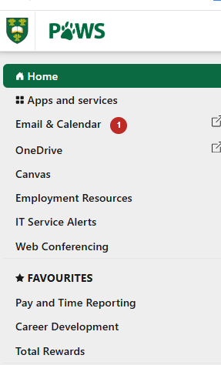
Example of Email
Step 1: Log into PAWS. Select “Pay and Time Reporting”
Notes:
You will receive an email to your usask email account.

Slide 83
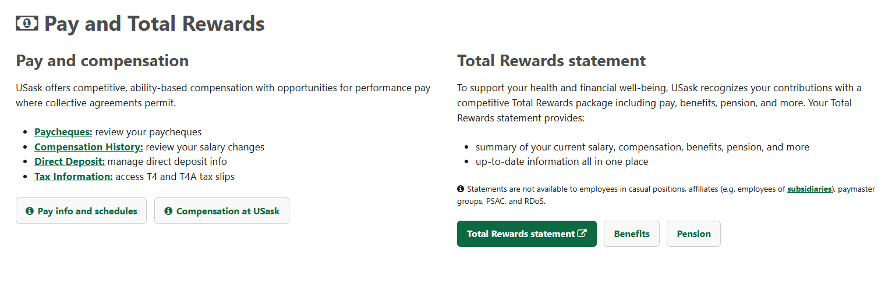
Example of Email
Step 2: Choose “Total Rewards Statement”
Notes:
You will receive an email to your usask email account.

Slide 84
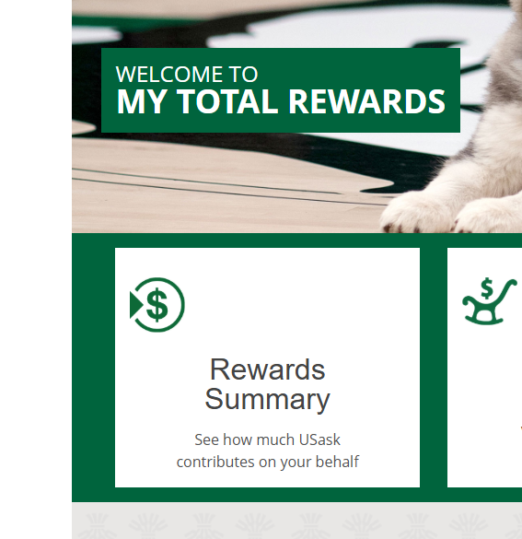
Example of Email
Step 3: Choose “Rewards Summary”
Notes:
You will receive an email to your usask email account.

Slide 85
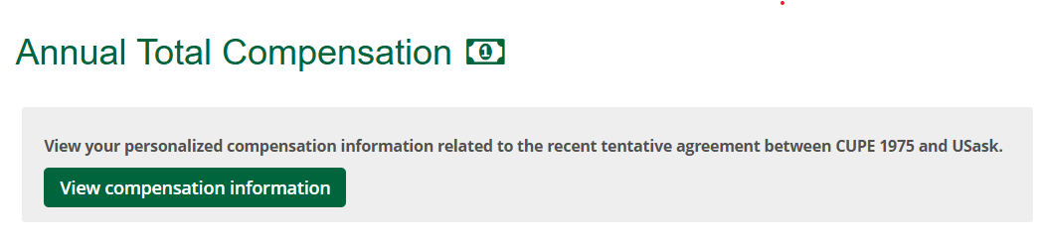
Example of Email
Step 4: Select “View Compensation Information”
Notes:
You will receive an email to your usask email account.

Slide 86
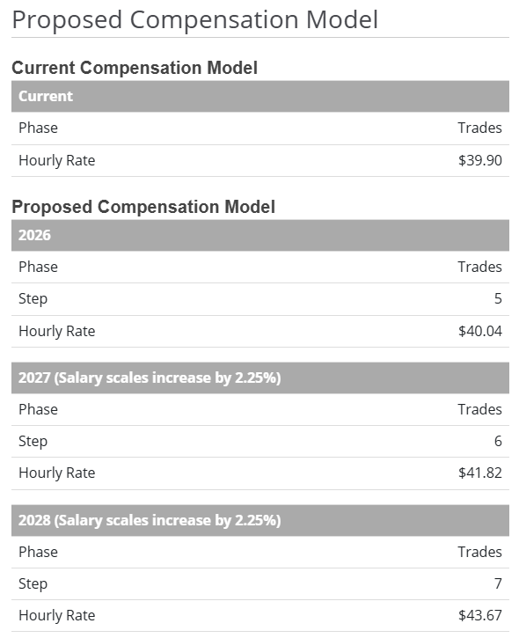
Example of Email
Step 5: This shows you your compensation schedule
Notes:
You will receive an email to your usask email account.

Slide 87
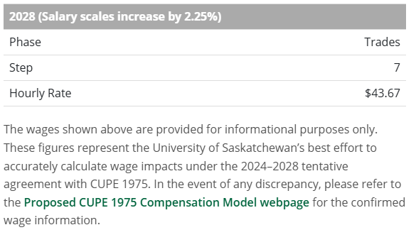
Example of Email
If you are entitled to a lump sum payment,
this is where it will show you the amount.
Notes:
You will receive an email to your usask email account.

Slide 88


This Photo by Unknown Author is licensed under CC BY-NC-ND
Notes:
WB/jsd:cope.491

